Slide 1
Unit 1 Syllabus
Introduction to Entrepreneurship
Definition of Entrepreneur, Entrepreneurial Traits,
Entrepreneur vs. Manager,
Entrepreneur vs Intrapreneur.
The Entrepreneurial decision process.
Role of Entrepreneurship in Economic Development,
Ethics and Social responsibility of Entrepreneurs. Opportunities for Entrepreneurs in India and abroad. Woman as Entrepreneur.

Slide 2
Entrepreneurship: Concepts & Definitions
“Entrepreneurship is the process of creating something new with value by devoting the necessary time and effort, assuming the accompanying financial, psychic, and social risks, and receiving the resulting rewards of monetary and personal satisfaction of independence.”…
Robert Hisrich

Slide 3
Entrepreneurship: Concepts & Definitions
“Entrepreneurship is an act of initiative, drive, commitment, diligence, perseverance, organized effort, and achievement outlook, to undertake some specific functions of performing productive activities and the capacity to bear and associated with the investment”.-- Economic Policy Paper on Entrepreneurship Development through Educational Reform-Bangladesh

Slide 4
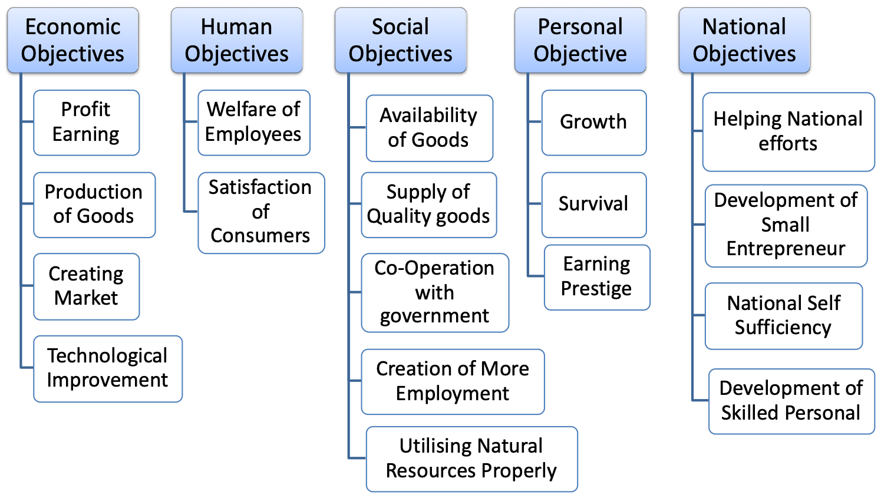
OBJECTIVES OF ENTREPRENEURSHIP

Slide 5
10 traits of the successful entrepreneur
1. Disciplined
Successful entrepreneurs are disciplined enough to take steps every day toward the achievement of their objectives.
2. Confidence
They are confident with the knowledge that they will make their businesses succeed. They exude that confidence in everything they do.
3. Open Minded
Ideas are constantly being generated about workflows and efficiency, people skills and potential new businesses. They have the ability to look at everything around them and focus it toward their goals.
4. Self Starter
They are proactive, not waiting for someone to give them permission.

Slide 6
10 traits of the successful entrepreneur
5. Competitive
An entrepreneur will highlight their own company’s track record of success.
6. Creativity
One facet of creativity is being able to make connections between seemingly unrelated events or situations. Entrepreneurs often come up with solutions which are the synthesis of other items. They will repurpose products to market them to new industries.
7. Determination
They are determined to make all of their endeavours succeed, so will try and try again until it does.
8. Strong people skills
Most successful entrepreneurs know how to motivate their employees so the business grows overall. They are very good at highlighting the benefits of any situation and coaching others to their success.

Slide 7
10 traits of the successful entrepreneur
9. Strong work ethic
The successful entrepreneur will often be the first person to arrive at the office and the last one to leave. They will come in on their days off to make sure that an outcome meets their expectations. Their mind is constantly on their work, whether they are in or out of the workplace.
10. Passion
Passion is the most important trait of the successful entrepreneur. They genuinely love their work. They are willing to put in those extra hours to make the business succeed because there is a joy their business gives which goes beyond the money. The successful entrepreneur will always be reading and researching ways to make the business better.

Slide 8
Entrepreneur vs Manager
Point of Distinction | Entrepreneur | Manager
1. Venture | An entrepreneur sets up a new enterprise or undertakes a venture for his personal gratification. | A manager does not take a new venture and renders services in an existing enterprise.
2. Riskbearing | An entrepreneur assumes risk of economic uncertainty involved in the enterprise. | A manager does not assume or share any risk involved in the enterprise he is serving.
3. Reward | The reward of an entrepreneur for his risk-bearing role is profits. It is not only uncertain and irregular but can at times be negative also. | The reward of a manager for rendering his services is salary which unlike profits is fixed and regular and can never be negative.
4. Continuity | Entrepreneurial activities are discontinuous appearing to initiate change in the production process and then disappearing until another change is initiated. | Managerial activities are mainly continuous involving an ongoing coordination of business operations.

Slide 9
Point of Distinction | Entrepreneur | Manager
5. Innovation | In order to maximise the profits, the entrepreneur applies innovation from time to time in the enterprise. Therefore, an entrepreneur is also called a change agent. | On the contrary, a manager simply keeps running the enterprise on already established lines on a routine basis. That is why a manager is called the product of change brought about by the entrepreneur.
6. Status-Role | An entrepreneur is his own boss and enjoys an independent status as the owner of the enterprise. | By contrast, a manager is a servant i.e. salaried person serving in the enterprise of some one else i.e. the entrepreneur. Thus, he is not independent but the dependent of the entrepreneur.
7. Prerequisites | In consonance with the entrepreneurial role, an entrepreneur needs pre-requisites like mission, creative thinking, risk-bearing ability, etc. | But, a manager needs distinct qualifications such as knowledge of human behaviour, management theory, etc. Because, the managers are made not born.

Slide 10
Entrepreneurs V. Intrapreneurs
Entrepreneurs are people that notice opportunities and take the initiative to mobilize resources to make new goods and services.
Intrapreneurs also notice opportunities and take initiative to mobilize resources, however they work in large companies and contribute to the innovation of the firm.
Intrapreneurs often become entrepreneurs.

Slide 11
Intrapreneurship
Learning organizations encourage intrapreneurship.
  Product Champions: people who take ownership of a product from concept to market.
  Skunkworks: a group of intrapreneurs kept separate from the rest of the organization.
  New Venture Division: allows a division to act as its own smaller company.
  Rewards for Innovation: link innovation by workers to valued rewards.

Slide 12

The Entrepreneurial decision Process
Starting the Venture:
  Researching Feasibility
  Planning the Venture
  Organizing the Venture
  Launching the Venture
Managing the Venture:
  Managing Processes
  Managing People
  Managing Growth
  Special Issues
Exploring the Entrepreneurial Context
Identifying
Opportunities/Possible
Competitive Advantage

Slide 13
ENTREPRENEURIAL DECISION PROCESS
Exploring the entrepreneurial context
Identifying opportunities and possible competitive advantage
Starting the venture
i) Researching feasibility
ii) Planning the venture
iii) Organizing the venture
iv) Launching the venture
4. Managing the venture
Managing processes
Managing people
Managing people and Entrepreneurial challenges

Slide 14
ROLE OF ENTREPRENEURSHIP IN ECONOMIC DEVELOPMENT
• Promotes capital formation by mobilizing idle savings
• Provides immediate large-scale employment
• Helps in reducing the concentration of economic power
• Stimulates equitable redistribution of wealth, income
• Promotes country’s export trade: an important ingredient to economic development
• Encourages effective resource mobilization of capital and skill

Slide 15
ROLE OF ENTREPRENEURSHIP IN ECONOMIC DEVELOPMENT Entrepreneurship: The Importance
Entrepreneurship and balanced regional development - Imbalanced regional development means a few sectors of an economy are developed and others remained undeveloped.
This is a major problem faced by an under developing country.
Entrepreneurs are not willing to invest in these sectors due to lack of availability of infrastructural facilities. It is the government who can encourage entrepreneurs to invest in these sectors by giving then subsidies and concessions.
balanced regional development can be ensured with the help of entrepreneurs
Increase in per capita income – How ?
Per capita income can be increased either by reducing population or by increasing national income.
Entrepreneurs play an important role in the growth of national income by utilizing the resources land, labour and capital. As they are innovators they can device new methods and techniques with minimum of cost and maximum profits which leads to increase in national income , increase in per capita income.

Slide 16
ROLE OF ENTREPRENEURSHIP IN ECONOMIC DEVELOPMENT Entrepreneurship: The Importance
Generation of employment -- Entrepreneurs firstly generate self employment and secondly be employing others in their enterprise , solve unemployment problem of others. Small scale units need less investment and absorb a large number of unemployed persons.
Raise standards of living -- Entrepreneurship help in rising the standard of living of people of the country. As entrepreneurs invest in small scale and large scale industries which leads to industrial growth in the country and industrial growth in turn leads to availability of abundance of goods for the consumers. As supply of goods increase it will lower the price of commodities, become accessible to every walk of people in under developed countries and improves their standard of living
Self Sufficiency -- Self sufficiency means a stage where a country is not dependent on world economy for its needs. Tools of self sufficiency are export promotion and import substitution. With the help of developed entrepreneurial structure a nation can increase its production. When the production of goods in the country is increased, the surplus which will left over after satisfying the domestic consumption can be exported, and with this we can earn foreign currency.

Slide 17
Features of Entrepreneurship
Innovation is an important function of entrepreneurship . Innovation means doing something new or doing old things in new or different way . It is the introduction of new methods and ways of doing the work. an entrepreneur should be innovative.
According to Drucker, innovation is the means by which entrepreneur either creates new wealth producing resources or endows existing resources with new products, services, ideas, and information”
Risk bearing. What are the types of risk?
Risk bearing is also an important function of entrepreneurship. Prof knight in his theory ‘ Risk uncertainty and profits’ defines there are two types of risk;
Foreseeable risk – is the risk which can be insured and capable of being calculated.
Unforeseeable risk.- is the risk which can’t be insured and it is tough to calculate it.

Slide 18
Features of Entrepreneurship
3. Organizing function
entrepreneurship can also be defined as an organizing function. Organization means organizing all the factors of production and directing them towards the attainment of the goal of organization.
4. Management skills.
Entrepreneur must posses managerial skills like motivation and leadership. Motivation is inner urge that emerges the behaviour towards achievement of goals. It can be positive and negative, financial and non-financial and leadership is to direct the people to do what you want your men to do.
5.Economic activity.
Entrepreneurship is an economic activity as it is concerned with earning more and more profits.
6. Goal oriented.
Entrepreneurship is an goal oriented activity. It is undertaken to achieve the predetermined goals of the entrepreneur.

Slide 19
The Social Entrepreneurship Movement
• Social Entrepreneurship
A new form of entrepreneurship applies to social problem solving tradition, private-sector entrepreneurship’s focus on innovation, risk-taking, and large scale transformation.
• Social Entrepreneurship Process
Recognition of a perceived social opportunity
Translation of the social opportunity into an enterprise concept
Identification and acquisition of resources required to execute the enterprise’s goals.

Slide 20
Social Entrepreneurs
A person or small group of individuals who founds and/or leads an organization or initiative engaged in social entrepreneurship.
Also referred to as “public entrepreneurs,” “civic entrepreneurs,” or “social innovators.
Characteristics of Social Entrepreneurs as Change Agents:
Adoption of a mission to create and sustain social value (beyond personal value)
Recognition and relentless pursuit of opportunities for social value
Engagement in continuous innovation and learning
Action beyond the limited resources at hand
Heightened sense of accountability

Slide 21
Ethics of Entrepreneurship
Ethics
A set of principles prescribing a behavioural code that explains what is good and right or bad and wrong; ethics may outline moral duty and obligations.
Provide the basic rules or parameters for conducting any activity in an “acceptable” manner.
• Reasons for Ethical Conflicts
The many interests that confront business enterprises both inside and outside the organization
Changes in values, mores, and societal norms
Reliance on fixed ethical principles rather than an ethical process

Slide 22
Entrepreneurial opportunities in India and Abroad
Water
IT & Telecom
Healthcare
Education
Entertainment
Real Estate
Rural Development
Transportation & Logistics
Infrastructure
Alternative Energy
Retail
Hospitality & Travel

Slide 23
Women as Entrepreneur
women entrepreneurs based on women participation in equity and employment of a business enterprise.
Accordingly, a woman entrepreneur is defined as an enterprise owned and controlled by a woman having a minimum financial interest of 51% of the capital and giving at least 51% of the employment generated in the enterprise to a woman.

Slide 24
Three categories of women entrepreneurs
First Category :
Established in big cities
Having higher level technical & professional qualifications
Non traditional Items
Sound financial positions
Second Category :
Established in cities and towns
Having sufficient education
Both traditional and non traditional items
Undertaking women services-kindergarten, crèches, beauty parlours, health clinic etc
Third Category:
Illiterate women
Financially week
Involved in family business such as Agriculture, Horticulture, Animal Husbandry, Dairy, Fisheries, Agro Forestry, Handloom, Power loom etc.

Slide 25
Problems faced by women entrepreneurs
• Start up finance
• Working capital management
• Marketing skills
• Access to technology
• Regulatory requirements
• Management skills
• Lack of confidence.

Slide 26
Motives of women as an Entrepreneur
• Imaginative
• Attribute to work hard
• Persistence
• Ability and desire to take risk
• Profit earning capacity

Slide 27
How to Develop Women Entrepreneurs?
• Consider women as specific target group for all developmental programs .
• Adequate training programme on management skills to be provided to women community.
• Encourage women's participation in decision-making.
• Training on professional competence and leadership skill to be extended to women entrepreneurs.

Slide 28

The Cultural Diversity of Entrepreneurship
Young entrepreneurs
Women
Minority-owned enterprises
Immigrant entrepreneurs
Part-time entrepreneurs
Home-based businesses
Family businesses
Copreneurs
Corporate cast-offs
Corporate dropouts

Slide 29


Slide 30
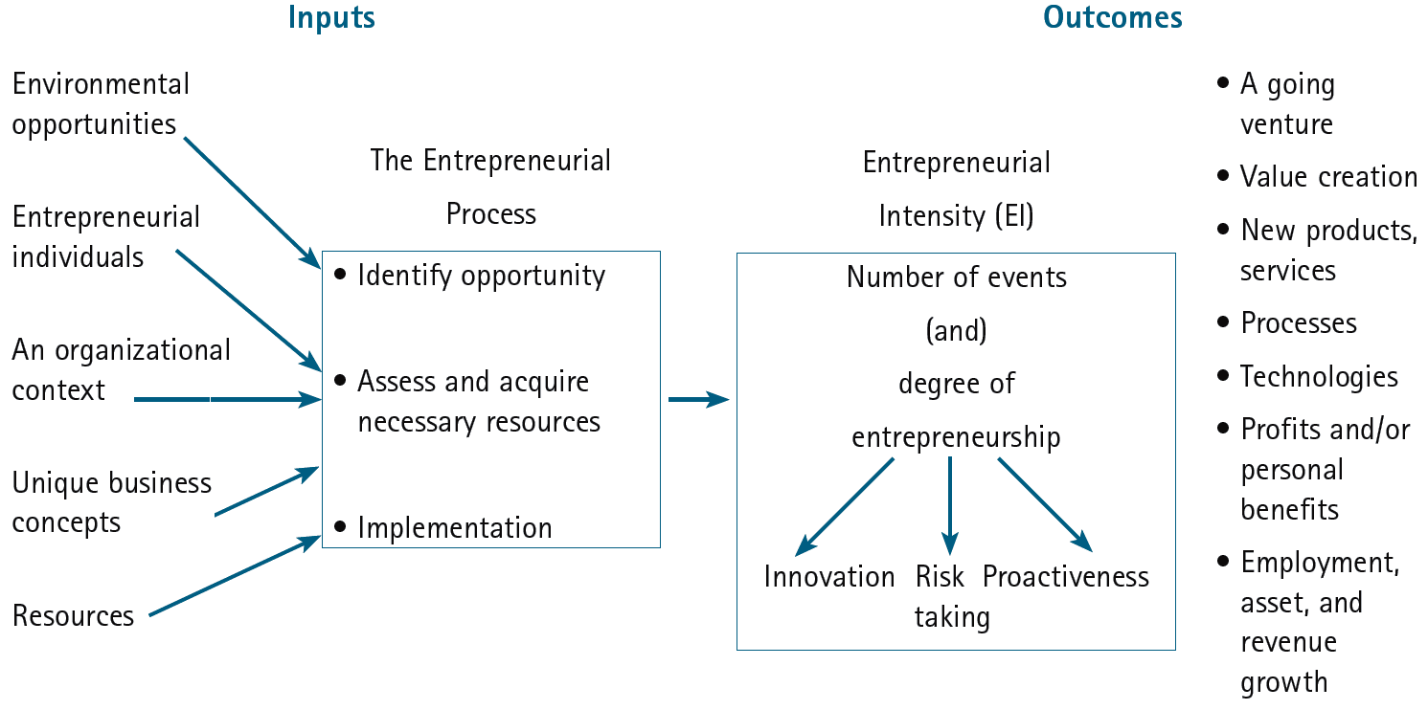
An Integrative Model of Entrepreneurial Inputs and Outcomes

Slide 31



Aspects of Entrepreneurship
Venture
Financing
Corporate Entrepreneurship
Social Entrepreneurship
Trends in Entrepreneurship Research
Entrepreneurial Cognition
Women
and Minority Entrepreneurs
Global Entrepreneurial Movement
Entrepreneurial Education
Family
Businesses

Slide 32
Key Elements in Entrepreneurship
Motivation & Commitment
Abilities & skill
Resources
Strategy & vision
Planning & organisation
The idea in relation to the market

Slide 33
Key Elements in Entrepreneurship
Motivation & Commitment
1. How does the motivation of an owner affect the business?
The motivation of the entrepreneur is driven by their type, of which there are three.
The “craftsman” entrepreneurs are focused on quality of life and are therefore seeking to satisfy themselves and to satisfy just one or two customers.
The “classical” entrepreneur is driven by profit. Their main driving force is to maximise returns from the market place.
The third area is one of a “manager” entrepreneur. They are strongly orientated and have a personal need to prove their worth through business success. They are likely to be in a mature market. A mature market is one where the customers know the product or service offering and do not need to be educated about. (where they can succeed.)

Slide 34
Key Elements in Entrepreneurship
Motivation & Commitment
2. How do (‘push and pull’) factors affect motivation to start a business?
Motivations to start a business - “push or pull”
Be my own boss 25%
Control over my life/independence 17%
Better financial prospects 13%
Spotted a market opportunity 14%
To make a lot of money 6%
To have a more balanced lifestyle 5%
No real alternative 12%
To do what I enjoy 5%
Source: Barclays Bank Survey (1992)
Push: factors are those that propel one into their own business, perhaps involuntarily at first e.g. redundancy..
Pull: factors are positive factors in the marketplace and in an individual’s character which makes them want to succeed e.g. market opportunity and the drive to succeed..

Slide 35
Key Elements in Entrepreneurship
Motivation & Commitment
3. What are the three main factors to consider when setting-up in business?
There are three factors that have to come into play when offering advice to people setting up and running a business. Those of 1) risk, 2) reward and 3) timing.
Risk: The risk may be too great in a volatile, changing market place, where the product requires constant changes and updates If you don’t have the resources in place to cover these problems, you risk will be higher.
Reward: Whilst the risk might be acceptable, the return or reward might not be adequate. The individual should be looking for a reasonable return for efforts in running that business.
Timing: Timing is crucial to the success of a business. Never enter a saturated market unless you have powerful point of difference or unique selling point. Early entrance to market should be the most successful strategy; satisfying initial demand and getting established as a recognised provider for future demand. Timing applies equally to resources. If you set up a market proposition but cannot produce the goods in time you will rapidly lose credibility and hence market share.

Slide 36
Key Elements in Entrepreneurship
Abilities & skill
Can anyone set up in business or do you have any special skills and characteristics?
The requirement for specialist skills and characteristics will depend on the industry. Some, not all, businesses require technical skills. Management skills are critical to all business.
Negotiating skills, selling skills, administrative skills, along with the ability to be able to identify target markets and customers are all required when setting up and running a business.

Slide 37
Key Elements in Entrepreneurship
Abilities & skill
Can anyone set up in business or do you have any special skills and characteristics?
The requirement for specialist skills and characteristics will depend on the industry. Some, not all, businesses require technical skills. Management skills are critical to all business.
Negotiating skills, selling skills, administrative skills, along with the ability to be able to identify target markets and customers are all required when setting up and running a business.

Slide 38
Key Elements in Entrepreneurship
Resources
How do you identify your resources and which is the most important one?
If you have got the motivation, the skill, the idea and the market place, resources is the next issue.
You need to think through how that business is going to operate, to walk yourself through the business. By doing this you will identify the type of people you require, the jobs that are going to be undertaken, the equipment, the finance, the customers and other resources particular to your business.
The resources have to be used in the most effective manner to be able to maximise the returns from the business. You need to develop the networks and the contacts which enable access to the appropriate resources at the right time. In this way you will continually add value to the business.

Slide 39
Key Elements in Entrepreneurship
Strategy & vision
What is the importance of strategy and vision, when starting a business?
You should be able to envisage what the business will look like in3, 5 and 10 years time. Equally you should be able to anticipate how you are likely to retain that position. It is through:
Developing the existing market or product
New products or markets
Developing a particular aim of the business, e.g. interests overseas

Slide 40
Key Elements in Entrepreneurship
Define problem/issue
Measure
results
Collect relevant data
Implement chosen solution
Develop alternative solutions
Select optimum solution
Assess consequences
The Classic Planning Cycle

Slide 41
Key Elements in Entrepreneurship
The idea in relation to the market
How do you choose a profit making idea?
The business idea is key to success. The idea itself might come about by friends and so forth.
To validate the idea it is a good idea to check with people who know about that particular industry. Do they think there is a gap on the marketplace and that the product could be serviced?
It is also a good idea to use the internet, to see if the idea has been done anywhere else in the world before.
Following discovery and validation of the idea, you must consider profitability. Can the product be sold at a profit and therefore generate the income stream that is required to run a successful business.

Slide 42
Entrepreneurship-Advantages
Generation of Employment.
Increasing per Capita Income.
Helping in Capital Formation.
Balanced Regional development.
Optimum Utilisation of Resources.
Promoting Self reliance.
Helps in raising living standards .
Mobilise the Idle savings & formation of capital.
Dispersal of economic wealth.
Economic independence.
Life line of Nation.

Slide 43
Entrepreneurship-Disadvantages
There are various factors responsible for the failure of entrepreneurship. Karl H Vesper has identified following entrepreneurship:
Lack of Viable concept.
Lack of market Knowledge.
Lack of technical skill.
Lack of seed Capital.
Lack of Business Knowledge.
Complacency-Lack of motivation.
Social Stigma.
Time pressure and distractions.
Legal constraints and regulations.
Monopoly and protectionism.
Inhibitions due to patents.
Low Level of Commitment
Shortage of Resources
Inferior Communication Network

Slide 44
Nine Deadly Mistakes of Entrepreneurship
Management incompetence
Lack of experience
Poor financial control
Failure to develop a strategic plan
Uncontrolled growth
Poor location
Improper inventory control
Incorrect pricing
Inability to make the “entrepreneurial transition”

Slide 45
Questions Bank (Short Questions)
Define entrepreneurship.
What are the kinds of objectives constitute the objectives of entrepreneurship?
How entrepreneurship plays vital role on nation development?
How to balance the regional development based on Entrepreneurship?
How to increase the capita income of the country?
How to rise the living standards of people?
What are the types of risks bearing in entrepreneurship?
What are the differences between starting venture and managing venture?
What are the similarities of entrepreneurs and intrapreneurs?
How do you differentiate entrepreneur with intrapreneur?
What are the ways of learning organisations encourage the intrapreneurship?
Enumerate the entrepreneurial decision process.
List the social entrepreneurship process.
What do you know about social entrepreneur?
What do you understand ethics of entrepreneurship?
What are the reasons for ethical conflicts.
List various entrepreneurial opportunities in India?
What are the categories of women entrepreneurs?
What are the problems faced by women entrepreneurs?
What are the motives women becoming an entrepreneur?
How to Develop Women Entrepreneurs?
What are the identified mistakes of entrepreneurship?

Slide 46
Questions Bank (Descriptive type Questions)
Discuss the common traits of successful Entrepreneur.
Explain the difference between Entrepreneur and Manager in an organization.
Explain the important elements in entrepreneurship.
Explain the entrepreneurial decision process.
Discuss the social entrepreneurship and entrepreneurs.
Discuss about women entrepreneurship and its emergence.
Discuss various key elements in entrepreneurship.
What are the advantages and disadvantages of entrepreneurship.
Explain the interactive model of entrepreneurial process.

